Slide 1
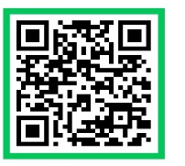
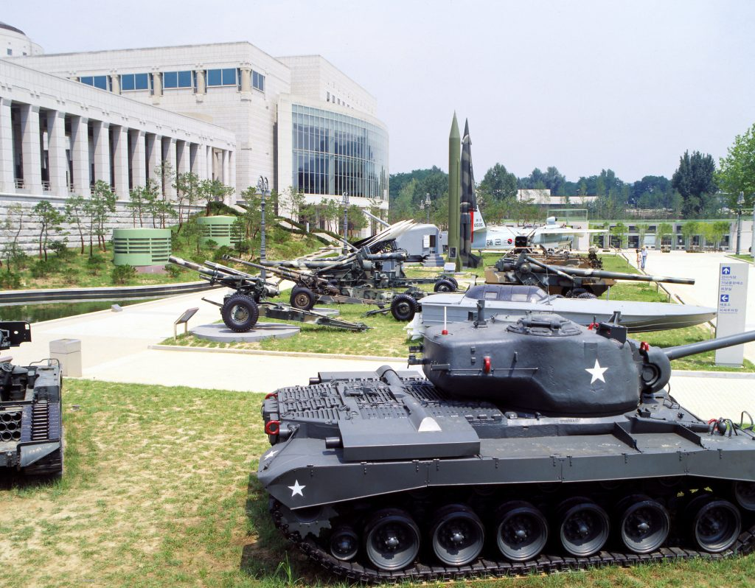
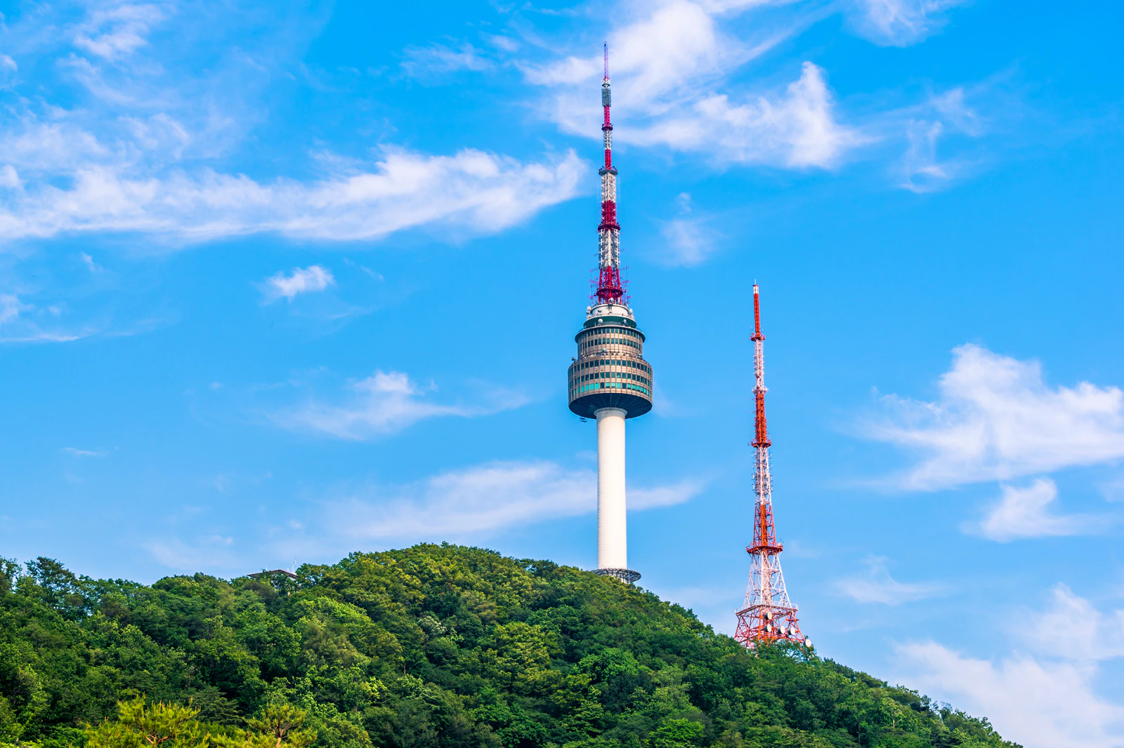
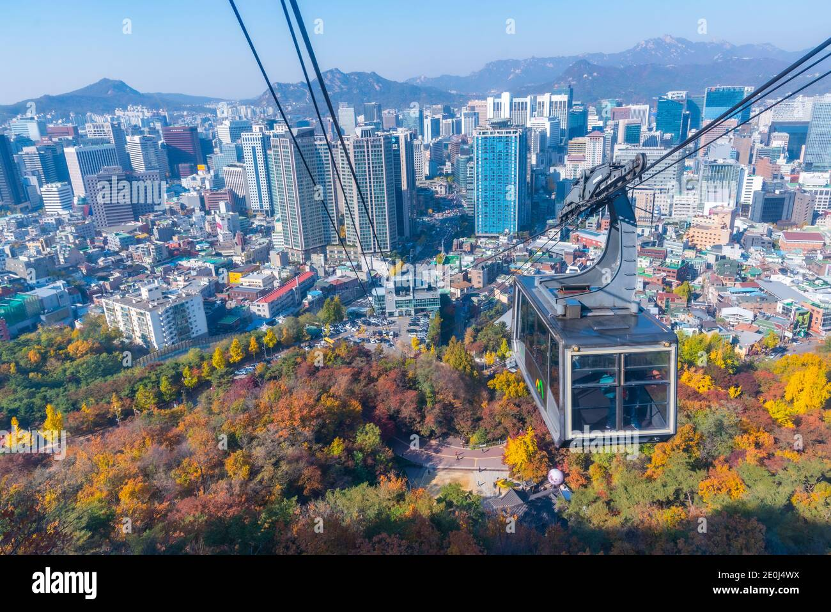
Family Readiness Group Trip CONOP – 3 APRIL 2024
UNCLASSIFIED//FOUO
TASK ORG: 3-2 GSAB Family Readiness Group Resiliency Trip
Mission: To support holistic spiritual wellness and resiliency for the 3-2 GSAB Soldiers and families based on the FM7-22. UMT will provide this trip for SFRG (70-80 people).
End State: Soldiers can get Family Union to provide resiliency, a sense of family closeness, and cultural understanding.
DTG Execution: Timeline
0650 : Accountability at Hangar Parking lot
0700 : Orientation and Departure
0830 : Arriving at DHL & Breakfast
0950 : War Museum & Wreath laying Ceremony
for honoring the fallen of Korean war
1200 : Departure for Seoul Tower
1230 : Riding the Cable Car & Lunch at tower
1500 : Watching Tower Show
1560 : AAR
1600 : Assemble the bus
1730 : Arrival at Humphreys & Dismissal
Concept of Operation:
PHASE I: Identify the location & venues
PHASE II: Advertising the event
PHASE III: Turn-in attendance roster
PHASE IV: Final check all venues and execution.
PHASE V : Assessment (AAR)
POC:
BN CH (CPT) BAEK, SEUNG EUN 010-7712-5170
BDE RA-NCOIC SPC Baltimore 010-4418-0713
BN KATUSA RA KCPR Yoo 010-8078-8859
Key Training Tasks:
Family Resiliency, building relationship,
visiting historical area, honoring to the fallen for Korean war, experiencing Korean culture and society.
Cli
QR for
registration
Service and Support:
UMT: All coordination with BN and Co. SFRG representatives.
BN UMT: Coordination with sponsors
S4 : Two Buses
Event Host : the Peaceful Unification Advisory Council (www.puac.go.kr/en/index.do)
Son, Hyoun Moon (010-7743-7745)
- will provide Breakfast, Lunch, Admission for Seoul Tower
Inclement Weather: mild cold Weather Clothing
UNCLASSIFIED//FOUO

